Slide 1
COLLECTIONS

Slide 2
Collections:
The Collection in Java is a framework that provides an architecture to store and manipulate the group of objects.
A Collection means a single unit of objects, i.e., a group.
Java Collections can achieve all the operations that you perform on a data such as searching, sorting, insertion, manipulation, and deletion.
Java Collection framework provides many interfaces (Set, List, Queue, Deque) and classes (ArrayList, Vector, LinkedList, PriorityQueue, HashSet, LinkedHashSet, TreeSet).
Framework:
It provides readymade architecture.
It represents a set of classes and interfaces.
It is optional.

Slide 3
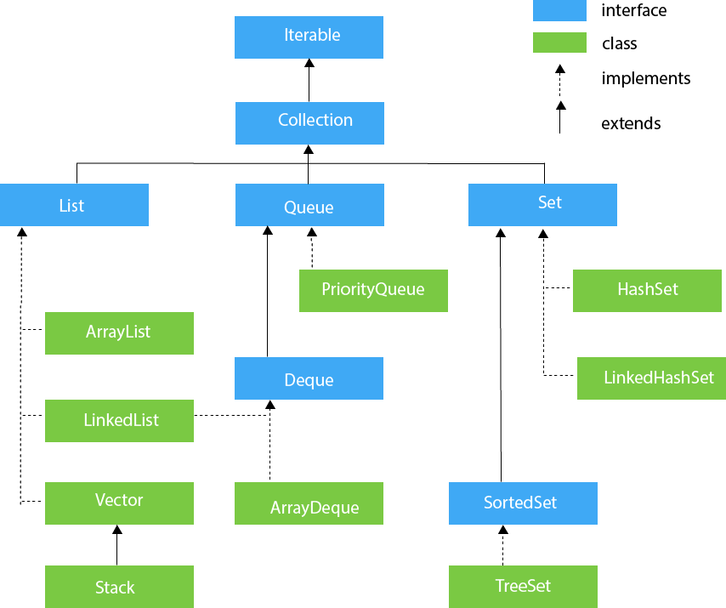

Slide 4
List Interface:
List interface is the child interface of Collection interface.
It inhibits a list type data structure in which we can store the ordered collection of objects i.e., insertion order.
It can have duplicate values.
List interface is implemented by the classes ArrayList, LinkedList, Vector, and Stack.
ArrayList:
The ArrayList class implements the List interface.
It uses a dynamic array to store the duplicate element of different data types.
The ArrayList class maintains the insertion order and is non-synchronized.
The elements stored in the ArrayList class can be randomly accessed.

Slide 5
Program for Arraylist:
import java.util.ArrayList;
import java.util.Iterator;
import java.util.List;
public class ListExample {
public static void main(String[] args) {
implementArrayListClass();
}
private static void implementArrayListClass(){
ArrayList<String> studentlist = new ArrayList<String>();
studentlist.add(null);
studentlist.add("Arun");
studentlist.add("Asha");
studentlist.add("anu");
studentlist.add("Hanna");
studentlist.add(null);
System.out.println(studentlist);

Slide 6
//another list creation
List<String> studentlistone = new ArrayList<String>();
studentlistone.add("Jagi");
studentlistone.add("Rino");
studentlistone.add("Jagirino");
studentlistone.add("Jagu");
System.out.println(studentlistone);
//addAll()---> It add the elements
studentlist.addAll(studentlistone);
System.out.println(studentlist);
// get()---> get the value from gived index position
System.out.println(studentlist.get(0));
//set()---> set the replaced values
System.out.println(studentlist.set(2,"Meena"));
System.out.println(studentlist);

Slide 7
//size()---> returns the length of the list
System.out.println(studentlist.size());
// toArray()--->toArray() convert a list into an array
// Create a new array of String type
// size of array is same as the ArrayList
String[] arr = new String[studentlistone.size()];
// Convert ArrayList into an array
studentlistone.toArray(arr);
// print all elements of the array
System.out.print("Array are : ");
//for each loop syntax....for(data type item:array)
for (String item : arr){
System.out.print(item +",");
}
System.out.println();

Slide 8
//contains() used to checking if the specified element is exist in the given list or not
System.out.println("contains method ");
if (studentlistone.contains("Jagi")){
System.out.println("Jagi present in list");
} else if (studentlistone.contains("Ammu")) {
System.out.println("Not present in studentlistone");
}else {
System.out.println("Jagi is not present in list");
}

Slide 9
//iterator()used to retriving object one by one from collection.
//it is a forwared direction,not backword direction
Iterator<String> iterator = studentlistone.iterator();
while (iterator.hasNext())
{
//hasNext() used toThe hasNext() method helps us to find the last element of the List. It checks if the List has the next element or not.
// If the hasNext() method gets the element during traversing in the forward direction,
// returns true, else returns false and terminate the execution.
System.out.print(iterator.next() +" ");
//The next() method perform the iteration
// in forward order. It returns the next element in the List
}
System.out.println();

Slide 10
//clone() used for copy the list(return to the object so typecasting is used)
ArrayList studentlistthree = (ArrayList) studentlist.clone();
System.out.println("Cloned object : " +studentlistthree);
//remove method()
String removestring = studentlistone.remove(1);
System.out.println("Remove the elements : " +removestring);
studentlist.removeAll(studentlist);
System.out.println("Remove all the elements : " +studentlist);
//subList()
System.out.println("sublist" +studentlistone.subList(0,3));
}
}

Slide 11
LinkedList:
Linkedlist implements the Collection interface.
It can store the duplicate elements.
It maintains the insertion order and is not synchronized.

Slide 12
Program for LinkedList:
import java.util.LinkedList;
public class LinkedListExample {
public static void main(String[] args) {
LinkedListExample linked =new LinkedListExample();
linked.implementLinkedListClass();
}
public void implementLinkedListClass(){
LinkedList<String> listone= new LinkedList<String>();
listone.add(null);
listone.add("Arun");
listone.add("Asha");
listone.add("Asha");
listone.add("Hanna");
listone.add(null);
System.out.println(listone);

Slide 13
//offer()---> used to element adds in the last position
listone.offer("Ravi"); //automatic add at last
System.out.println("Add the element in the last: " +listone);
listone.offerFirst("John"); //add at first
System.out.println("Add the element in the first: " +listone);
listone.offerLast("Tamil"); //add at last
System.out.println("Add the element in the last: " +listone);
//peek()---> This method retrives the element but does not remove
System.out.println("Using peek() : " +listone.peek()); //automatic show first element
System.out.println("Using peekFirst() : " +listone.peekFirst()); //show first element
System.out.println("Using peekLast() : " +listone.peekLast()); //show last element

Slide 14
//poll()--->This method retrives and removes the list of elements
System.out.println("Using poll() : " +listone.poll());
System.out.println(listone);
System.out.println("Using pollFirst() : " +listone.pollFirst());
System.out.println(listone);
System.out.println("Using pollLast() : " +listone.pollLast());
System.out.println(listone);
//Arraylist method are same as LinkedList
}
}

Slide 15
Map Interface:
Map in java is an interface available in java.util package.
It stores the data in key and value pairs.
Each key and value pair is known as Entry.
A map contains unique key.
It does not allow duplicate keys.
Use:
Keep the values in the form of key and value pairs.
It is useful to search, update or delete elements on the basis of a key.

Slide 16
Program:
import java.util.*;
public class MapInterfaceExample {
public static void main(String[] args) {
// mapinterface();
MapInterfaceExample obj = new MapInterfaceExample();
obj.hashMapClass();
// obj.LinkedHashMap();
// obj.treeMap();
}

Slide 17
private static void mapinterface(){
Map studentDetails = new HashMap();
studentDetails.put("Jagi","104");
studentDetails.put("Rino","101");
studentDetails.put("Danya","105");
studentDetails.put("Jaya","102");
studentDetails.put("Raj","107");
studentDetails.put("Mary","109");
studentDetails.put("sun","108");
studentDetails.put("null",null); // allow null value
System.out.println("Map Output:" + studentDetails);
System.out.println("Entry set is:" + studentDetails.entrySet());
System.out.println("Key set is:" + studentDetails.keySet());
System.out.println("values is:" + studentDetails.values());
}

Slide 18
private void hashMapClass(){
HashMap<Integer, String> fruitslist = new HashMap<>();
fruitslist.put(1,"Apple"); //key and values are object
fruitslist.put(2,"Orange");
fruitslist.put(3,"Mango");
fruitslist.put(null,"Papaya");//can store n number of null value, but only one in key, take last value
fruitslist.put(null,"grapes");
System.out.println(fruitslist);
//putAll()
HashMap<Integer, String> fruitsListOne = new HashMap<>();
fruitsListOne.put(4,"Banana");
fruitsListOne.put(5,"Kiwi");
fruitslist.putAll(fruitsListOne);
System.out.println("Add the element in another"+fruitslist);

Slide 19
//iterating hashmap. Entry using for each loop
for (HashMap.Entry<Integer,String> entryobj : fruitslist.entrySet())
System.out.println("Key is " +entryobj.getKey() +", value is " +entryobj.getValue());
System.out.println("................");
// iterator while loop
Iterator<Map.Entry<Integer,String>> itr = fruitslist.entrySet().iterator();
while (itr.hasNext()){ // hashNext()--> check before and after, the element is or not
Map.Entry<Integer,String> entry = itr.next();
System.out.println("Key is: " +entry.getKey() +", Value is: " +entry.getValue());
}
}

Slide 20
private void LinkedHashMap(){
LinkedHashMap<Integer,String> fruitslist = new LinkedHashMap<>();
fruitslist.put(1,"Apple"); // key and value are object
fruitslist.put(2,"Orange");
fruitslist.put(3,"Mango");
fruitslist.put(4,"Papaya");
fruitslist.put(5,"Grapes");
fruitslist.put(null,"Grapes"); // It may have one null key and multiple null values.
fruitslist.put(null,"Potato"); // print last assign entries(key,value)
fruitslist.put(6,null); // duplicate null value are allow
fruitslist.put(7,null);
System.out.println(fruitslist); //insertion order
}

Slide 21
private void treeMap(){
TreeMap<Integer,String> fruitslist = new TreeMap<>();
fruitslist.put(1,"Apple"); // key and values are object
fruitslist.put(2,"Orange");
fruitslist.put(3,"Mango");
fruitslist.put(4,"Papaya");
fruitslist.put(5,"Grapes");
fruitslist.put(5,"Grapes");
fruitslist.put(5,"Potato");
fruitslist.put(6,null);
fruitslist.put(7,null);
System.out.println(fruitslist);
System.out.println();
}
}

